Slide 1
Disaster 101
Whitney Bailey
Erica Fields

Slide 2
Erica Fields
Disaster Response Attorney
ericaf@ardfky.org
Whitney Bailey
Disaster Response Project Director
whitneyb@ardfky.org

Slide 3
What will this session cover?
What is a disaster?
Statutory authority
Disaster declaration process
Sources of disaster assistance
Overview of DR-4860-KY
How can attorneys assist disaster survivors?
Common legal issues and when they arise
Where to connect with potential clients

Slide 4
May 2024 Tornadoes
What is a disaster?
Photo: Louisville Courier Journal
July 2022 Floods
Photo: New York Times

Slide 5
Robert T. Stafford Disaster Relief and Emergency Assistance Act of 1988: the Stafford Act
Citation: 42 U.S.C. Chapter 68 (§§5121-5208); 44 C.F.R. §§206.1-206.440
Major Disaster defined (42 U.S.C. §5122)
Any natural catastrophe which in the determination of the President causes damage of sufficient severity and magnitude to warrant federal assistance
Establishes the Presidential disaster declaration process (42 U.S.C. §5170; 44 C.F.R. Part §206, Subpart B)
Gives any federal agency the authority to manage federal disaster assistance at the direction of the President (42 U.S.C. §5170a)
FEMA is the workhorse, but other agencies implicated as well, such as HUD
Notes:
https://www.fema.gov/disaster/how-declared
Note for audience, to add at end of slide: FEMA was not created by the Stafford Act. President Carter created FEMA by executive order in 1979. The Stafford Act gave FEMA more work to do.
FEMA used to be an independent agency but was absorbed into the Department of Homeland Security when it was formed in 2002.

Slide 6
The Disaster Declaration Process
Weather is coming…
1) Governor may declare a State of Emergency*
Notes:
https://www.fema.gov/disaster/how-declared
Kentucky is in FEMA Region 4 office located in Atlanta, GA. https://www.fema.gov/about/organization/region-4

Slide 7
SIDE QUEST*
State of Emergency | Emergency Declaration
WHO Declared by Governor | WHO Declared by President
WHEN During a situation or imminent threat of widespread or severe damage, injury or loss of life or property, resulting from a natural or man-made cause | WHEN Pre-Disaster: Governor or Tribal Chief Executive may request an emergency declaration in advance or anticipation of the imminent impact of an incident that threatens such destruction as could result in a major disaster. OR Within 30 days of the occurrence of the incident
WHAT - Enable government officials to take extra measures to protect the public - Trigger anti-price gouging laws - Seek state or federal funding aid for disaster response if it is warranted | WHAT - Supplement State and local or Indian tribal government efforts in providing emergency services, such as the protection of lives, property, public health, and safety, or to lessen or avert the threat of a catastrophe in any part of the United States The total amount of assistance provided for in a single emergency may not exceed $5 million Public Assistance, Individual Assistance (rare), Hazard Mitigation Grant Program
Notes:
https://www.fema.gov/disaster/how-declared

Slide 8
The Major Disaster Declaration Process
2) “Natural catastrophe” occurs
3) If more money and manpower is needed than State’s capacity, State contacts their FEMA Regional Office and requests a joint Federal/State Preliminary Damage Assessment (PDA). Local government representatives ideally included as well.
PDA of impacted area will determine:
(i) The extent of the disaster
(ii) Its impact on individuals and public facilities
(iii) The types of federal assistance that may be needed
Notes:
https://www.fema.gov/disaster/how-declared
Natural catstrophe: including any hurricane, tornado, storm, high water, winddriven water, tidal wave, tsunami, earthquake, volcanic eruption, landslide, mudslide, snowstorm, or drought), or, regardless of cause, any fire, flood, or explosion, in any part of the United States
Acronyms: https://www.fema.gov/sites/default/files/documents/fema-acronyms-abbreviations-terms_FAAT_03-2023.pdf
Kentucky is in FEMA Region 4 office located in Atlanta, GA. https://www.fema.gov/about/organization/region-4

Slide 9
The Major Disaster Declaration Process
4) After PDA completed and State determines that the damage exceeds their resources, the State submits a declaration request to the President through their FEMA Regional Office within 30 days of the incident.
5) President issues a Major Disaster Declaration for any natural event that the President determines has caused damage of such severity that it is beyond the combined capabilities of state and local governments to respond.
Notes:
https://www.fema.gov/disaster/how-declared
Must be “damage of sufficient severity and magnitude” to warrant federal assistance

Slide 10
A Major Disaster Declaration opens the door for FEMA Individual Assistance, Public Assistance, and Hazard Mitigation Assistance.
Volunteer attorneys will only work with applicants for Individual Assistance.
Notes:
FEMA’s Public Assistance Program provides supplemental grants to state, tribal, territorial, and local governments, and certain types of private non-profits so communities can quickly respond to and recover from major disasters or emergencies.

Slide 11
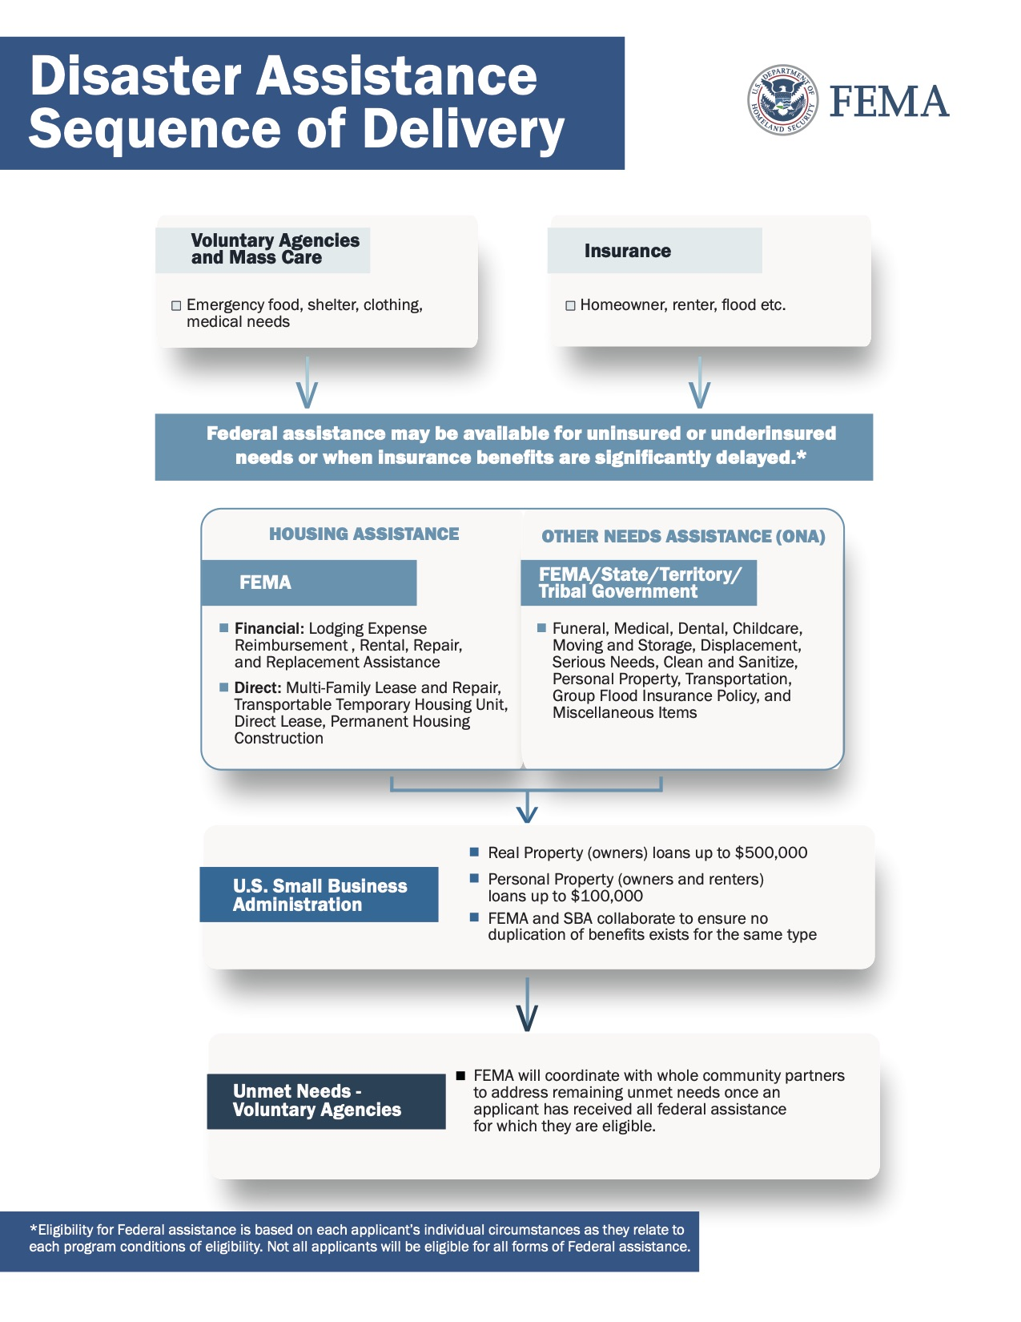
Notes:
This is an important graphic because one question your clients will probably have is "if my appeal gets denied, where else can I get help?" Let's go over it.

Slide 13
Notes:
We've provided this handout to everyone and have sent a link in the chat. This is an important graphic because one question your clients will probably have is "if my appeal gets denied, where else can I get help?" Let's go over it.

Slide 14
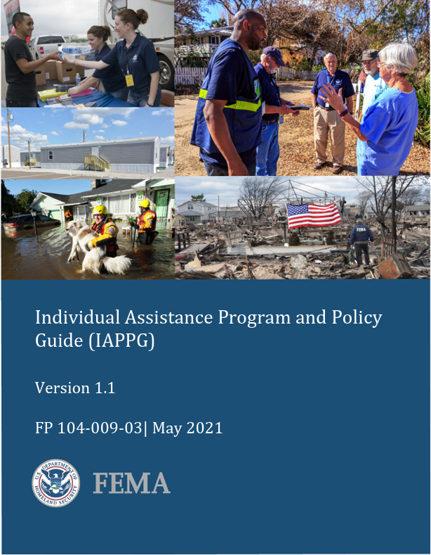
FEMA Individual Assistance
Individual Assistance Program and Policy Guide “IAPPG”
FEMA September 2021 Ownership and Occupancy Memo
FEMA March 22, 2024 IAPPG Updates Memo
FEMA Acronyms, Abbreviations, and Terms
Notes:
We'll discuss deadlines further in the appeal drafting presentation.
Common acronyms in the disaster world: If you come across an acronym you don't understand, either today or as you’re assisting clients, please feel free to refer to the "Disaster Terms, Abbreviations, and Acronyms" handout we've provided.

Slide 15
FEMA Individual Assistance
Individual Assistance may include:
Individuals and Households Program*
Crisis Counseling Program: IAPPG Chapter 5
Disaster Case Management (DCM): IAPPG Chapter 4
Disaster Legal Services: IAPPG Chapter 6
State can also request Disaster Unemployment Assistance (DUA) and Disaster Supplemental Nutrition Assistance Program (D-SNAP)
Notes:
We'll discuss deadlines further in the appeal drafting presentation.
Common acronyms in the disaster world: If you come across an acronym you don't understand, either today or as you’re assisting clients, please feel free to refer to the "Disaster Terms, Abbreviations, and Acronyms" handout we've provided.

Slide 16
FEMA Individual Assistance
Disaster survivors apply for assistance through the Individuals and Households Program (IHP)
IAPPG Chapter 3, 2021 Memo, 2024 Memo
Individuals and Households Program period of assistance is limited to 18 months following the date of the Presidential disaster declaration and may be extended due to extraordinary circumstances (42 U.S.C. §1574)
Survivors who are living in FEMA temporary housing or receiving FEMA Rental Assistance may receive an extension past 18-month period of assistance. Most survivors must transition out of Manufactured Housing Unit, may be offered MHU for purchase, or pay rent for MHU.
Notes:
We'll discuss deadlines further in the appeal drafting presentation.
Common acronyms in the disaster world: If you come across an acronym you don't understand, either today or as you’re assisting clients, please feel free to refer to the "Disaster Terms, Abbreviations, and Acronyms" handout we've provided.

Slide 17
FEMA Individual Assistance
Survivors do not have 18 months to apply for assistance!
Survivors have 60 days from the disaster declaration date to submit an initial application for assistance.
Application deadlines may (and usually are) extended.
Late applications may be excepted for certain reasons.

Slide 18
DR-4860-KY Snapshot

Slide 19
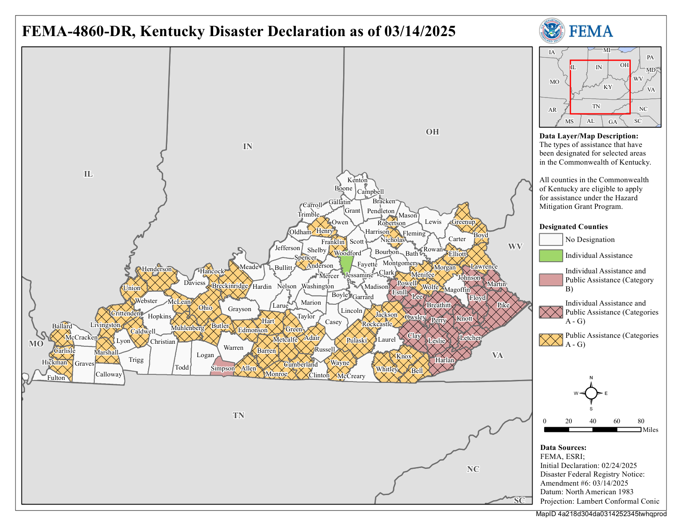

Slide 20
DR-4860-KY
Name of disaster: Kentucky Severe Storms, Straight-line Winds, Flooding, Landslides, and Mudslides
Dates of disaster (incident period): February 14, 2025 – March 7, 2025
State of emergency declared on February 15 for all 120 counties (EM-3624-KY)
Major Disaster Declaration on February 24 (DR-4860-KY)
16 designated counties for FEMA Individual Assistance
AppalReD serves 14 counties: Breathitt, Clay, Estill, Floyd, Harlan, Johnson, Knott, Lee, Leslie, Letcher, Martin, Owsley, Perry, and Pike
Kentucky Legal Aid in Western Kentucky serves Simpson County
Legal Aid of the Bluegrass serves Woodford County
https://www.fema.gov/disaster/4860

Slide 21
When are attorneys needed?
Photo by Whitney Bailey of a funeral home in Bakersville, NC after Hurricane Helene; waterline up to top of door frame.
Taken November 2024.
AppalReD Legal Aid Pro Bono Program Director, Charnel Burton (left), and Prestonsburg Directing Attorney, Kristie Goff (right), providing pro bono services at a Disaster Recovery Center in North Carolina.

Slide 22
Notes:
Kristy Vick-Stratton will discuss legal issue spotting during her presentation

Slide 23
Why are disaster legal services important?
Disasters are increasing in frequency and cost
Congressional Research Service: “The average number of Stafford Act major disaster declarations has increased from an average of 39 per fiscal year in the first decade after its enactment (FY1988-1997) to an average of 63 in the most recent ten fiscal years—an increase of 61%”
Since 2005, AppalReD Legal Aid's service area had 36 total declarations; 14 in last 5 years
5 Emergency (EM)/Fire Management (FM)
31 Major Disaster Declarations (DR); 15 with IA
Disaster recovery is inequitable
Disparate impact on low-income communities, the elderly, and other vulnerable groups

Slide 24
Where are attorneys needed?

Slide 25
Disaster Recovery Centers (DRCs)
WHAT: Temporary field office for federal & state agencies
WHO: FEMA, Small Business Administration (SBA), state agencies (e.g. D-SNAP, DUA, Office of Vital Statistics, Transportation Cabinet), legal aid
WHY: Survivors can apply for assistance, ask questions about FEMA correspondence, get copies of letters, learn about other resources
WHERE: Currently 18 DRCs open for DR-4860-KY (locations and hours on FEMA.gov)
Notes:
(We'll be explaining SBA earlier in the "Disaster Assistance Sequence of Delivery" slide so we don't have to re-define it now)
Once we are able to get into the DRCs, we hope to provide tabling opportunities for volunteer attorneys to help survivors sort out what may be a legal issue and if a referral to legal aid may be necessary. Volunteer attorneys will be able to sign up for shifts.

Slide 26
Clinics
Virtual and in-person
Potential topics: FEMA appeals, landlord/tenant issues, drafting simple estate planning documents
Next confirmed: May 6, 2025 in Harlan County

Slide 27
Case Referrals
Volunteer attorney or other community partner as primary advocate
Practice areas where volunteer attorneys are most needed after a disaster: complex title clearing and probate cases; insurance disputes; mortgage issues (e.g. foreclosures)

Slide 28
Questions?
Raise your hand or drop ‘em in the chat!
Email us:
WhitneyB@ardfky.org
EricaF@ardfky.org

